Slide 1
Best Location Turkish Restaurant
Final Capstone Presentation

Slide 2
Section 1 - Introduction
Tourism sees on annual basis almost 27.5m tourist. An attractive destination for all types of tourist offering loads of attractions, parks, music and event. - Tourist spend on aveverage 6.5B dollars - 6.4B dollars in hotels booking - An overall impact of 10.3B dollar. - Accommodation, food, drink and performing arts contribute 70% of all tourism activities
Objective The exercise is to try and identify a location / zone to establish a Turkish restaurant around Ontario, Toronto, targeting tourist & business customers. Location: Scarborough is known for its diverse cultural landscape and proximity to tourist locations. Foursquare API: Primary data source for this exercise will be sourced from Four Square. Which will cover the 4 main categories accomodation, food, drink and performance arts

Slide 3
Section 2 - Data Section
To be able to determine the ideal location for opening a Turkish restaurant, i will explore the area for various types of venues and compare them with respect to business zone and tourist attractions. capturing venue name, location, venue categories. The data collected will then be used to create hot zones and identify the best zone for an investment.
List of data to be collected from Foursquare would include but not limited to ( in addition to the data already sourced from wikipedia and geo - Venue Name - Venue location (Longitude / Latitude) - Venue Category (targeting: accommodation, food, drink and arts mainly) - Neighborhood name - Neighborhood location (Longitude / Latitude) - volume of traffic at the venue (if available) - volume of recommendation (if available) data source: 1. Data on Toronto - https://en.wikipedia.org/wiki/List_of_postal_codes_of_Canada:_M 2. Geolocation data - https://cocl.us/Geospatial_data 3. Venue data - www.foursquare.com

Slide 4
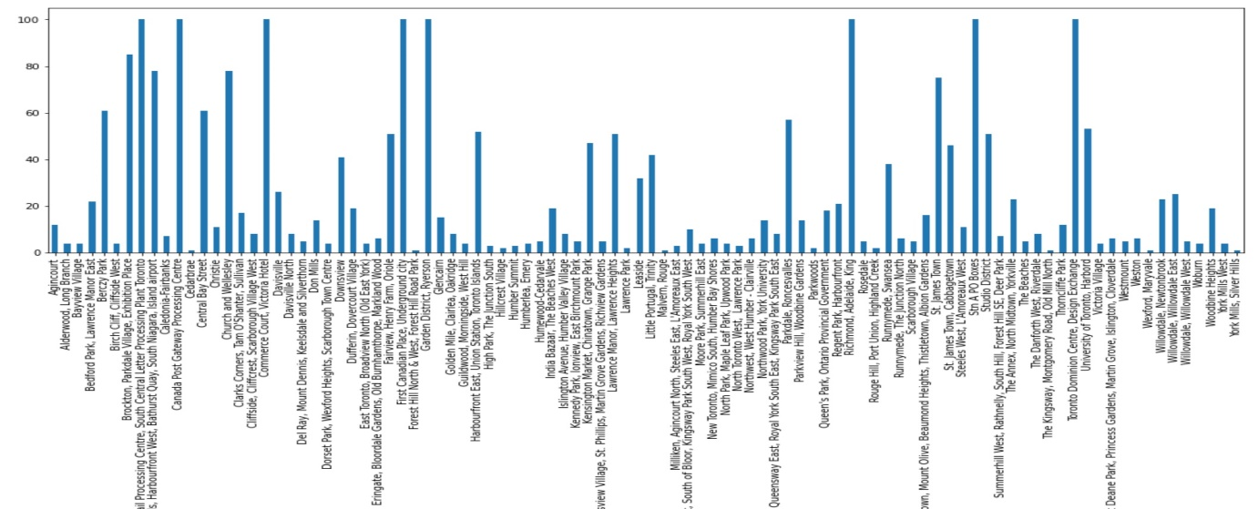
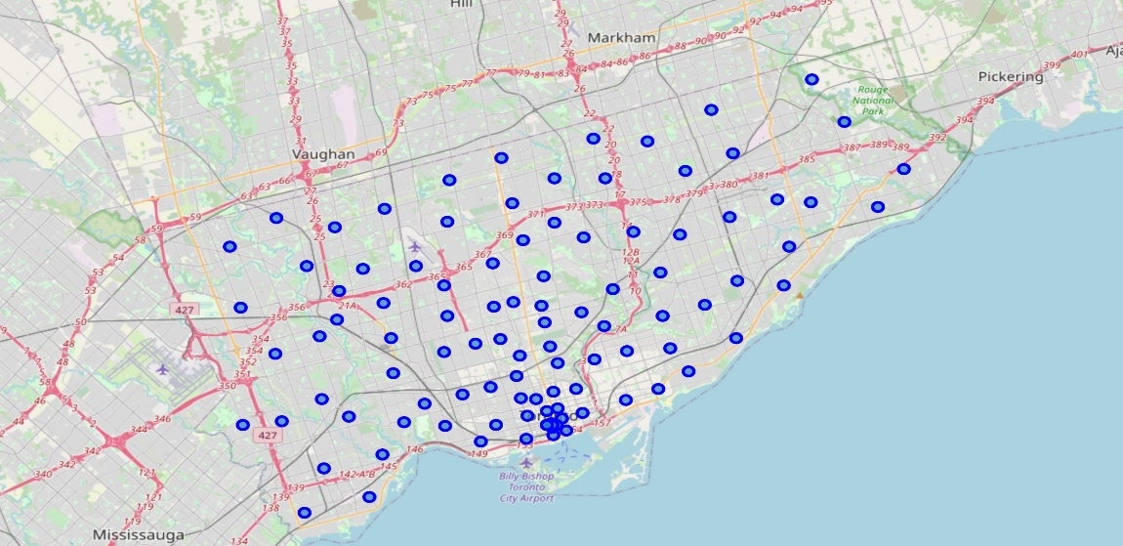
Section 3 - Methodology
Now that I have the data structured and identified venue data by neighborhood using Foursquare. - Total of 96 Neighborhoods - Containing 260 unique Venue Categories I will now examine the neighborhoods and identify the number of Turkish restaurants per neighborhood. I will achieve this by clustering venue category in each neighborhood. I will then proceed to determine the optimal clusters, accordingly proceed to determine the spread of the clusters based neighborhoods across Toronto. After having determined the clusters, i will propose based on cluster density, cluster size and number of restaurants the ideal cluster to focus on to establish the Turkish restaurant
# of Venues per neighborhood
Neighborhood in Toronto

Slide 5
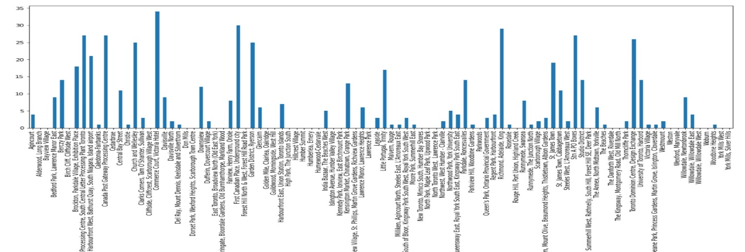
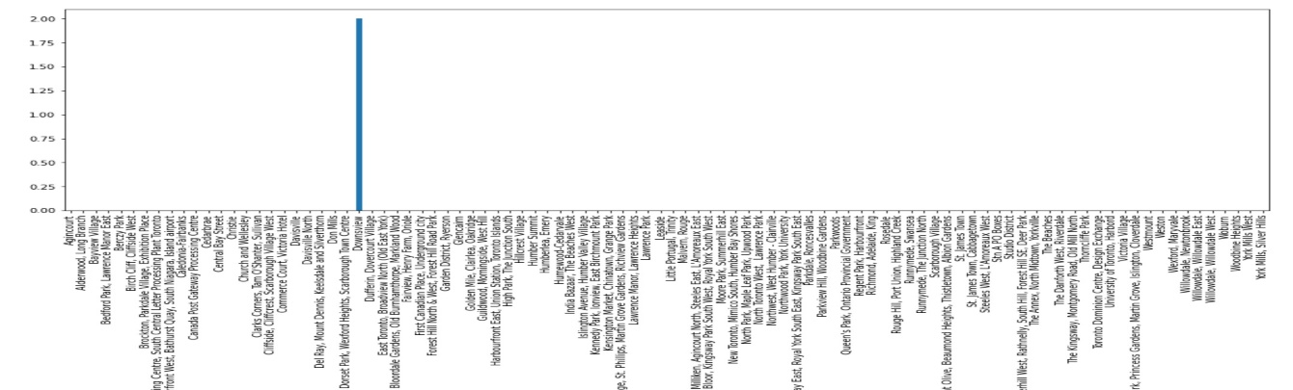
Section 4 - Results
Objective of the exercise was to determine an area to start a new Turkish restaurant. Cluster 0 mainly consisting of neighborhoods around downtown seems to be the ideal location.
# of Restaurants per neighborhood
# of Turkish restaurants per neighborhood
Having seen that the number of Turkish restaurants is just 2 across all of Toronto, this poses as a good opportunity to open a new outlets. As the data is insufficient to determine a good locations, we will work with all types of restaurants to determine a hot spot for establishment

Slide 6
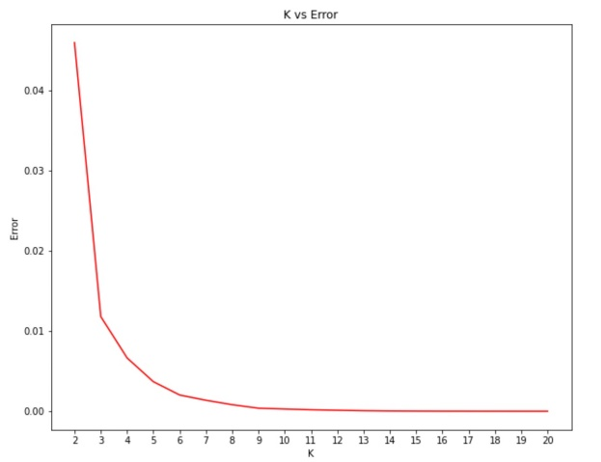
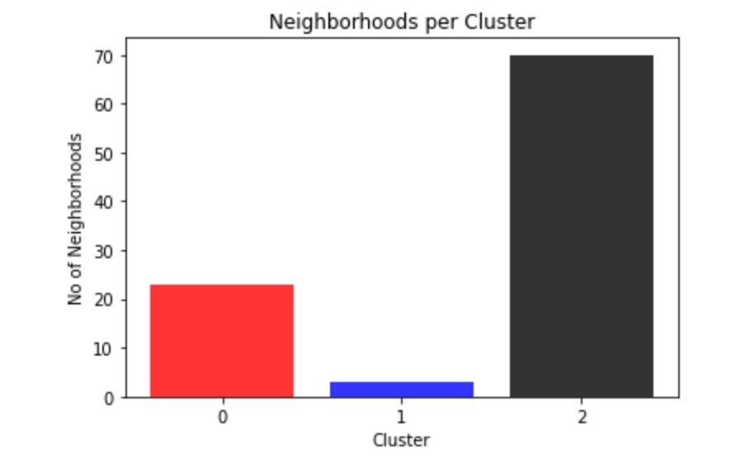
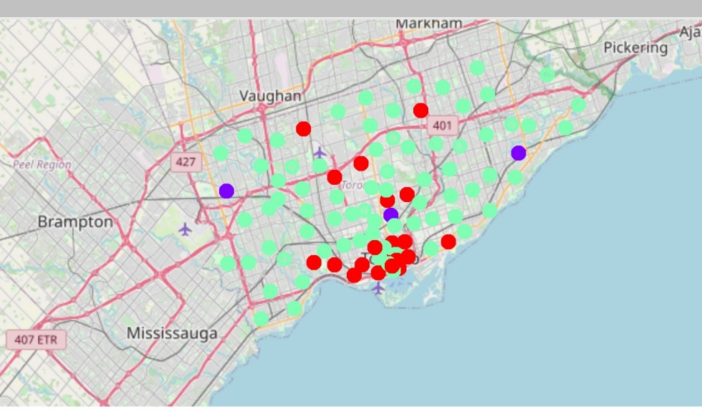
Section 4 – Results (cont.)
Based on grouping of data, I determined the number of clusters as shown in figure below. Optimal number of cluster equal to 3
Created the cluster map which reflect the spread of each group across Toronto
It was clear from both the map and the number of neighborhoods per cluster that cluster zero seemed like the optimal cluster
Determine Number of Clusters
Clusters across Toronto

Slide 7
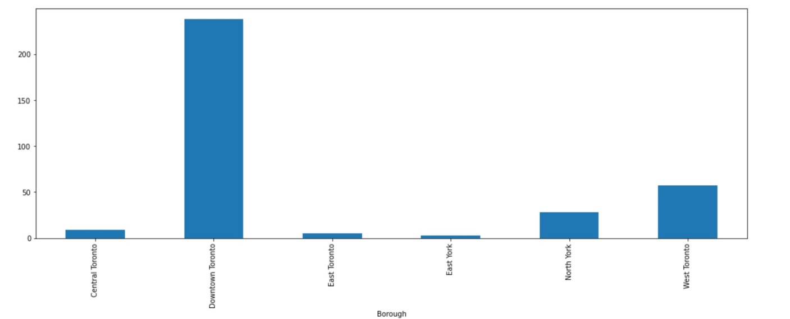
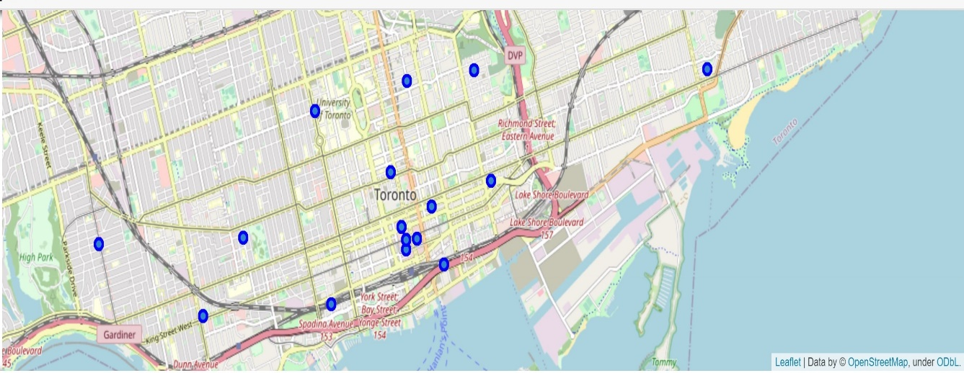
Section 4 – Results (cont.)
Further investigate cluster zero, it clearly reflected downtown had the maximum number of restaurants equal 238
No Turkish restaurants
On average each neighborhood contains 15 restaurants
Cluster contains a good mix of neighborhoods catering for business, tourism and Food.
# of Restaurants across Boroughs
Restaurants across downtown

Slide 8
Section 5 - Discussion
Data model was built as tool to determine the best location for a Turkish restaurant
The data model is good as the source of the data;
- Foursquare was the only source of venue data and could be limited, exercise could be continued with further inputs to determine if there are any other Turkish restaurants in cluster 0
- additional tourism data can be integrated to determine number of Turkish tourist/residents in Toronto to further enhance data model

Slide 9
Section 6 - Conclusion
Exercise was successfully completed based on factual data collected from various sources, using tools such as
- beautiful soup - Pandas - numpy - matplotlib - Follium Using the tools I structured the data and used various graphs / clustering methodologies to determine the best location for a Turkish restaurant.
I am confident based on the model created anyone who wishes to establish Turkish restaurant in Toronto downtown area will be successful in the venture.

